Slide 1


Cross Language Emotion Detection
ROSALIND MARGARET PAULSON(M23CSA526)
Sachchida Nand Tiwari(M23CSA527)

Slide 2
Cross Language Emotion Detection
Cross-Language Emotion Detection is the task of identifying and analyzing emotions from text, speech, or other modalities in multiple languages. Cross-language speech emotion recognition (SER) is a challenging yet essential task for practical applications, especially in multilingual environments.
SER plays a crucial role in various domains:
Healthcare
Customer Support
Human-Robot Interaction
Security & Surveillance

Slide 3

Comparison of SOTA Models
Paper | Model | Dataset | Metric
Improved multi-lingual sentiment analysis and recognition using deep learning | MFCC Random Forest, XGBoost Classifier | EMO-DB, EMOVO, SAVEE and URDU | Accuracy
Toward language-agnostic speech emotion recognition | MFCC, temporal modulation features GMM | EMOVO, EMODB | average recognition rate
A Study of Cross-Linguistic Speech Emotion Recognition Based on 2D Feature Spaces | 2D feature spaces: cochleagrams, spectrograms, mel-cepstrograms, and fractal dimension CNN | Lithuanian (Lithuanian Spoken Language Emotions Database recordings), RAVDESS, SAVEE and TESS Polish Emotional Speech Dataset Spanish (Spanish emotional speech synthesis database recordings) Serbian (Serbian emotional speech GEES database recordings) German (Berlin emotional speech database recordings). | Accuracy, F1 Score
Bangla Speech Emotion Recognition and Cross-Lingual Study Using Deep CNN and BLSTM Networks | The system combines a deep convolutional neural network (DCNN) and a bidirectional long-short term memory (BLSTM) network with a time-distributed flatten (TDF) layer | SUBESCO, RAVDESS | weighted accuracies (WAs)
Transfer learning for improving speech emotion classification accuracy | Binary valence mapping eGeMAPS feature set - Low-Level Descriptor (LLD) Deep Belief Networks | FAU-AIBO, IEMOCAP, EMO-DB, SAVEE, EMOVO | Accuracy

Slide 4
Comparison of SOTA Models
Paper | Model | Dataset | Metric
Emotional Vietnamese Speech-based Depression Diagnosis Using Dynamic Attention Mechanism | MFCC, Mirror padding Dynamic Convolutional Block Attention Module to utilized with in an Attention-GRU Network | Vietnamese Speech Emotion dataset (VNEMOS) | Unweighted Accuracy (UA), Weighted Accuracy (WA) rate and F1 score
Multimodal Speech Emotion Recognition Using Audio and Text | Dual recurrent neural networks (RNNs) high-level text transcription + low-level audio signals | Interactive Emotional Dyadic Motion Capture (IEMOCAP) | weighted average precision (WAP)
Self Supervised Adversarial Domain Adaptation for Cross-Corpus and Cross-Language Speech Emotion Recognition | Adversarial Dual Discriminator(ADDi) network | IEMOCAP, MSPIMPROV, RECOLA, EMODB, FAU-AIBO and LibriSpeech | unweighted average recall rate (UAR)
Semi-supervised cross-lingual speech emotion recognition | SER recognition backbone Adaptation module | English (RAVDESS, SAVEE and TESS), French (CaFE), German (EmoDB), Italian (EMOVO), and Persian (ShEMO). Emotions - anger (A), fear (F), happiness (H), neutral (N), and sadness (S) | accuracy

Slide 5
Comparison of SOTA Models
Paper | Model | Dataset | Metric
Breaking Barriers: Can Multilingual Foundation Models Bridge the Gap in Cross-Language Speech Emotion Recognition? | Baseline - CNN-LSTM model Pretraining - W2V2/XLSR/Whiper/MMS Finetuning - parameter-efficient fine-tuning (PEFT) technique | IEMOCAP (English) EMODB (German) EMOVO (Italian) URDU (Urdu) | Unweighted average recall (UAR)
Cross-lingual speech emotion recognition system based on a three-layer model for human perception | Acoustic feature selection method based on a human perception model. | Japanese - utterances using 5 emotional speech categories, i.e., neutral expression, joy, cold anger, sadness, and hot anger - 179 utterances German - Berlin database. It comprises seven emotional states: anger, boredom, disgust, anxiety, happiness, sadness, and neutral speech. 69 frightened; 46 disgusted; 71 happy; 81 bored; 79 neutral; 62 sad; 127 angry | confusion matrix - average recognition rate
Cross corpus multi-lingual speech emotion recognition using ensemble learning | MFCCs, Spectral (Roll-off, flux, centroid, bandwidth), Energy (Root-mean-square energy), Raw Signal (Zero crossing rate), Pitch (Fundamental frequency), and Chroma features The synthetic minority oversampling technique (SMOTE) SVM with puk Kernel, complexity 1.0, and pairwise multi-class discrimination based on Sequential Minimal Optimization, Random Forest, Decision Tree - Ensemble Learning through majority voting. | EMO-DB, EMOVO, SAVEE and URDU | accuracy, precision, recall, and f-score

Slide 6
Strengths and Limitations of SOTA Models
Model | Strengths | Limitations
CNN | Efficient for feature extraction | Struggles with long-term dependencies
RNN/LSTM | Good for sequential data processing | Computationally expensive
Transformers | Superior accuracy, less manual feature engineering | Requires large-scale data and high computational power
CNN-LSTM | Effective for dynamic speech patterns | Complexity increases training time
Dynamic Attention-GRU | High accuracy for specific tasks | Limited cross-lingual generalization
MDRE | Resolves class bias with multimodal fusion | Heavy computational requirements
emotion2vec | Generalizes across languages and tasks | High pre-training data and computational cost

Slide 7
Evaluation Metrics
SER models are evaluated using different performance metrics:
Accuracy: Measures overall correctness.
Precision, Recall, and F1-score: Assess class-wise performance.
Confusion Matrix: Visualizes misclassification patterns.
Mean Squared Error (MSE) & Root Mean Square Error (RMSE): Evaluates regression-based emotion models.
Weighted Accuracy (WA): Reflects overall accuracy but biased toward majority classes.
Unweighted Accuracy (UA): Balances class-wise performance, critical for imbalanced datasets.
Unweighted Average Recall(UAR): Calculated by averaging the recall for each class in a multi-class classification problem.
Mean absolute error (MAE): MAE between the predicted values of emotion dimensions and the corresponding average value given by human subjects is calculated.

Slide 8
Open Challenges and Future Opportunities
Data Scarcity: Limited high-quality emotional speech datasets. Labeled emotion datasets are small and expensive to collect.
Cross-Language and Cross-Cultural Variability: SER models often fail to generalize across languages.
Real-World Noisy Environments: Many models perform poorly in real-world settings with background noise.
Multimodal Emotion Recognition: Combining facial and textual cues with speech could improve accuracy.
Lightweight Models for Edge Devices: Optimizing models for deployment on low-resource hardware.
Cross-Cultural Generalization: Models trained on Western datasets (e.g., IEMOCAP) underperform on non-English languages (e.g., Bangla in SUBESCO).
Noise Robustness: Performance drops in real-world noisy environments (e.g., call centers).
Opportunity
Self-supervised models (e.g., emotion2vec) reduce reliance on labeled data.
Multimodal Fusion: Integrating text, video, or physiological signals could improve accuracy (e.g., MDRE’s audio-text fusion).
Ethical Concerns: Bias in emotion labeling (e.g., cultural stereotypes) and privacy risks.

Slide 9

Speech Understanding Programming Assignment 1

Slide 10
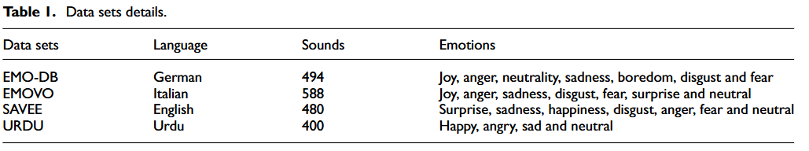
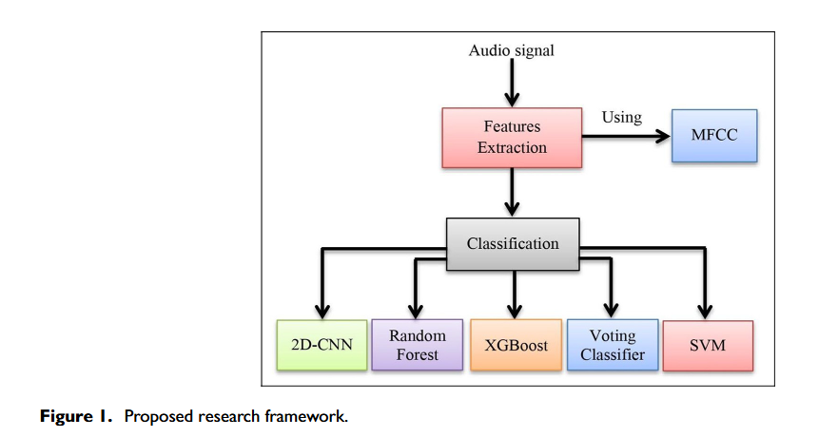
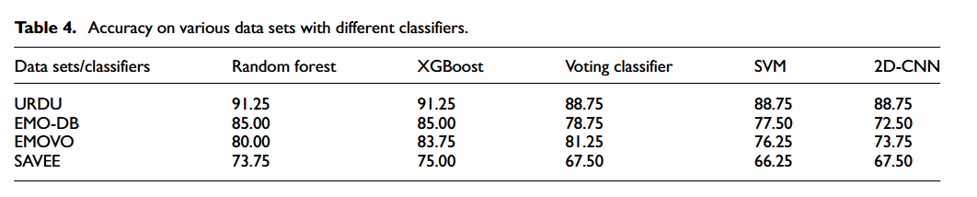

Slide 11
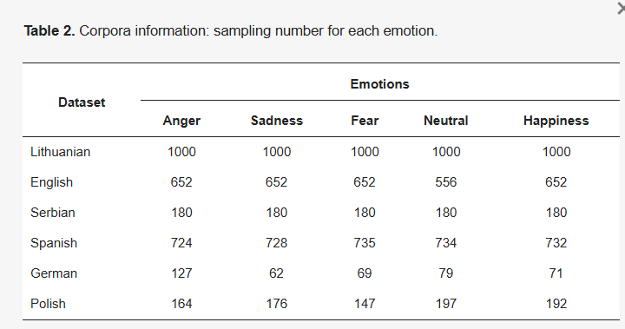
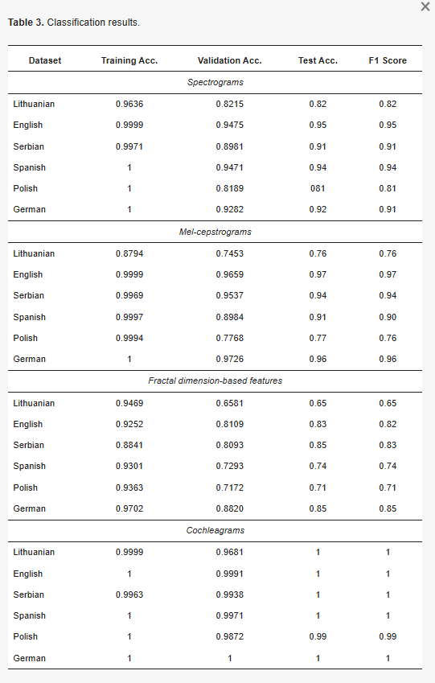
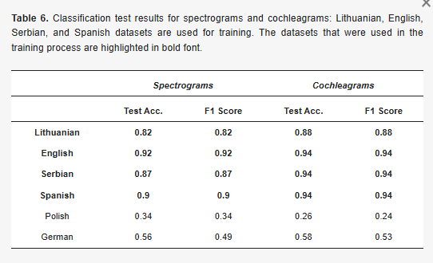

Slide 12
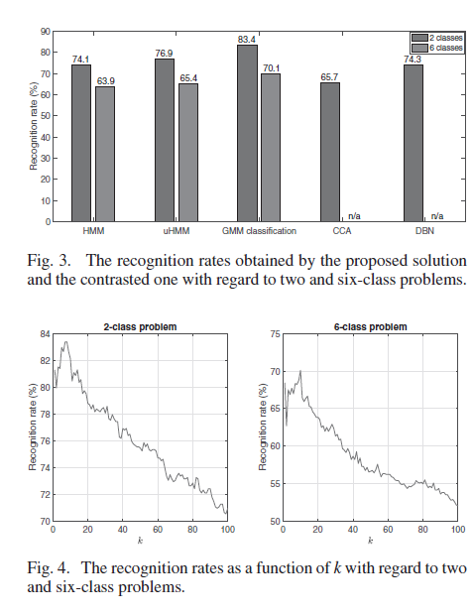
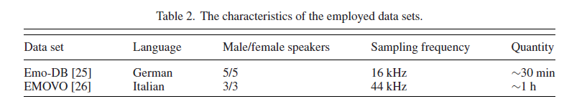
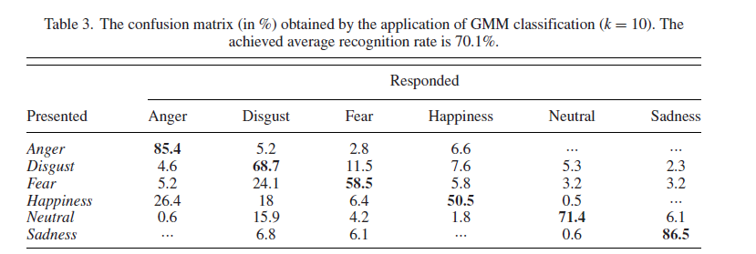
k = nearest neighbours

Slide 13
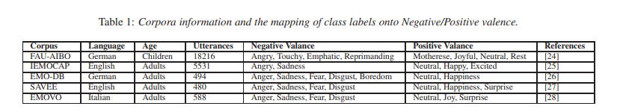
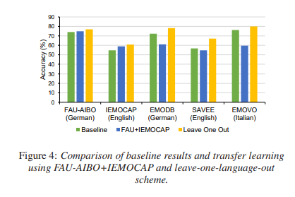

Slide 14
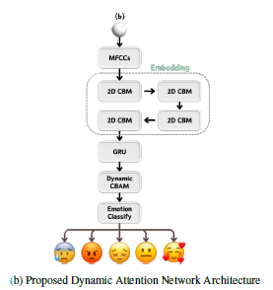
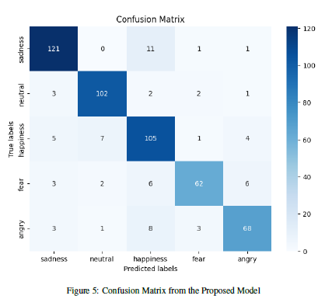
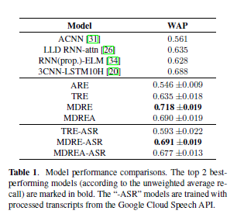
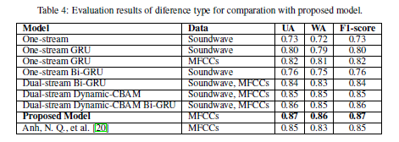
Multimodal Speech Emotion Recognition Using Audio and Text

Slide 15
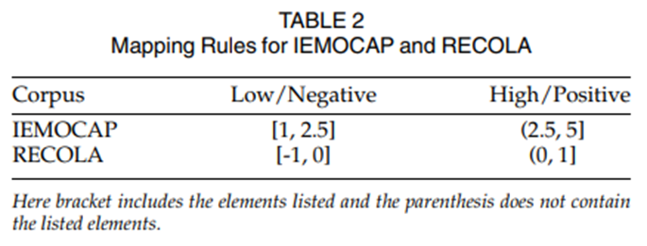
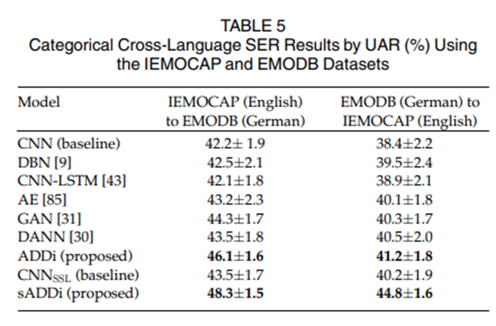
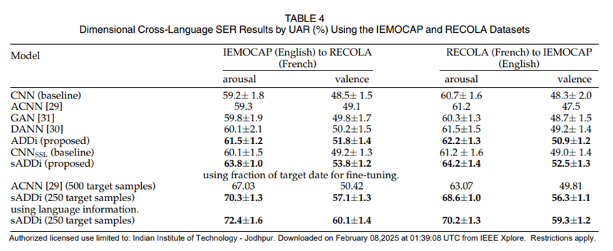

Slide 16
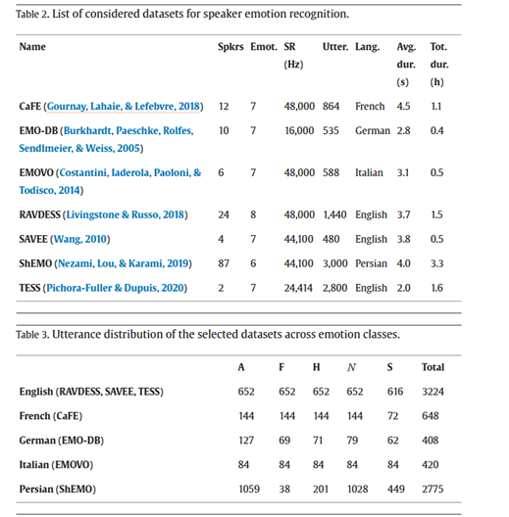
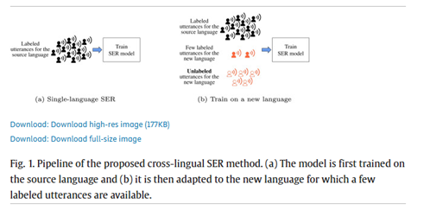
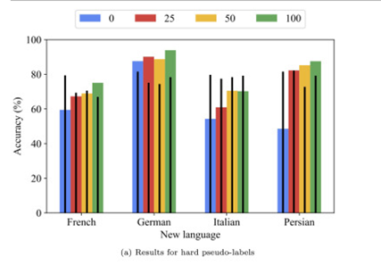
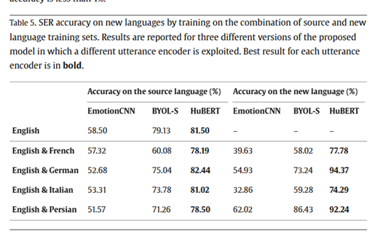
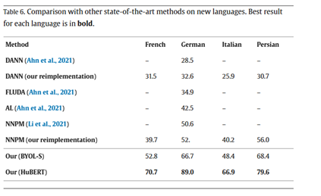

Slide 17
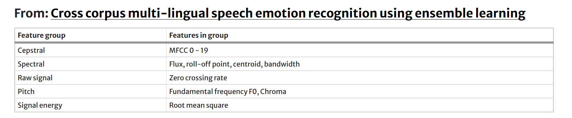
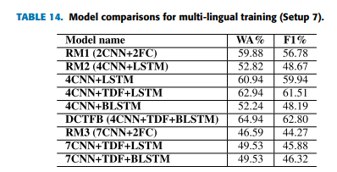
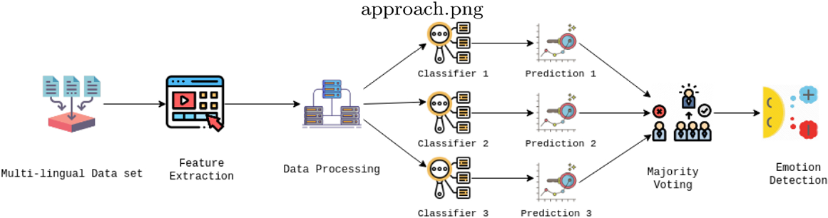
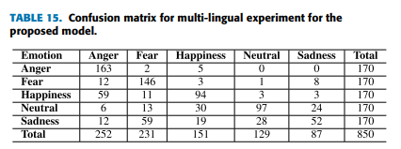
Bangla Speech Emotion Recognition and Cross-Lingual Study Using Deep CNN and BLSTM Networks

Slide 18
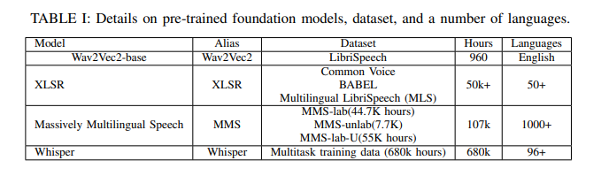
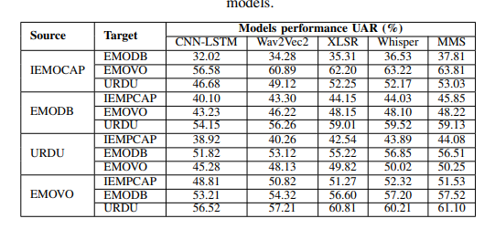

Slide 19
